Slide 1

FINAL PROJECT: TITANIC
MATH 4995
TSUI YING TSZ, HARJONO NATASHA VALERIE

Slide 2

Introduction
Data Overview
MATH 4995 FINLAL PROJECT
There are two datasets in csv format which is, the training set and the test set.
The training set has 891 rows
12 columns with one observation identifier (passengerid), one target variable (survived)
10 predictor variables.
Test data has 418 rows with 11 columns, without the target variable column.
02

Slide 3

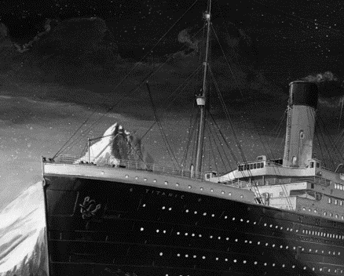
Test
MATH4995 FINAL PROJECT
Train
481 PEOPLE
11 COLUMNS
NON-TARGET VARIABLE
891 PEOPLE
12 COLUMNS
TARGET VARIABLE
03

Slide 4
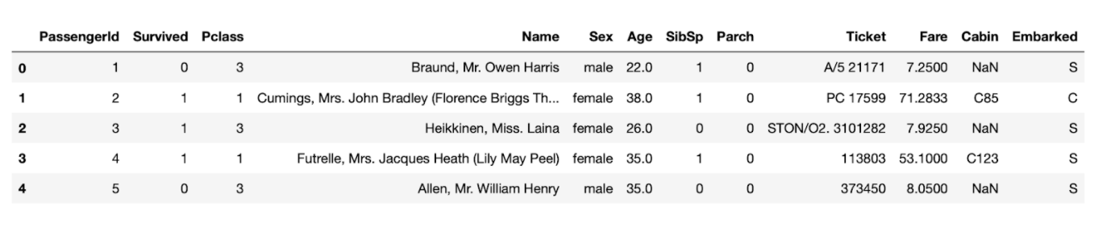
Data Overview
The dataset consists of 12 features including numerical, categorical and nominal data:
Passenger ID: A unique integer identifier for each passenger
Survived: A categorical integer indicates whether the passenger survived
Pclass: A categorical integer indicates passenger's class of travel
Name: The passenger's name including title if known
Sex: The passenger's gender
Age: An integer represents the passenger's age in years
Sibsp: An integer of siblings and spouses the passenger had on board
Parch: An integer records the number of parents and children passenger had on board
Ticket: An object records ticket ID
Fare: A float indicates the fare paid
Cabin: An object records cabin of travel
Embarked: A categorical string of S, C or Q indicates where passengers embarked
MATH4995 FINAL PROJECT
04

Slide 5
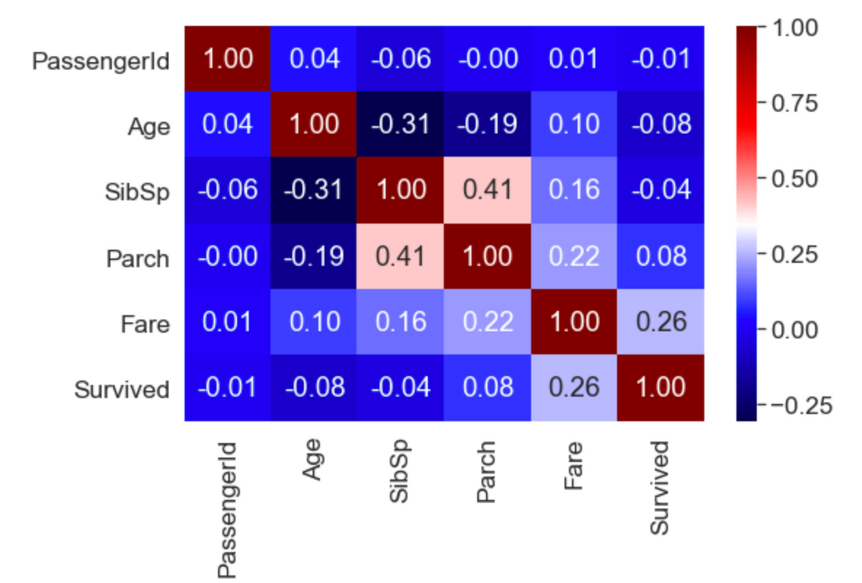
Data Analysis
MATH4995 FINAL PROJECT
The figure shows the Pearson's Correlation Coefficient (PCC) for numerical values in the dataset.
05

Slide 6
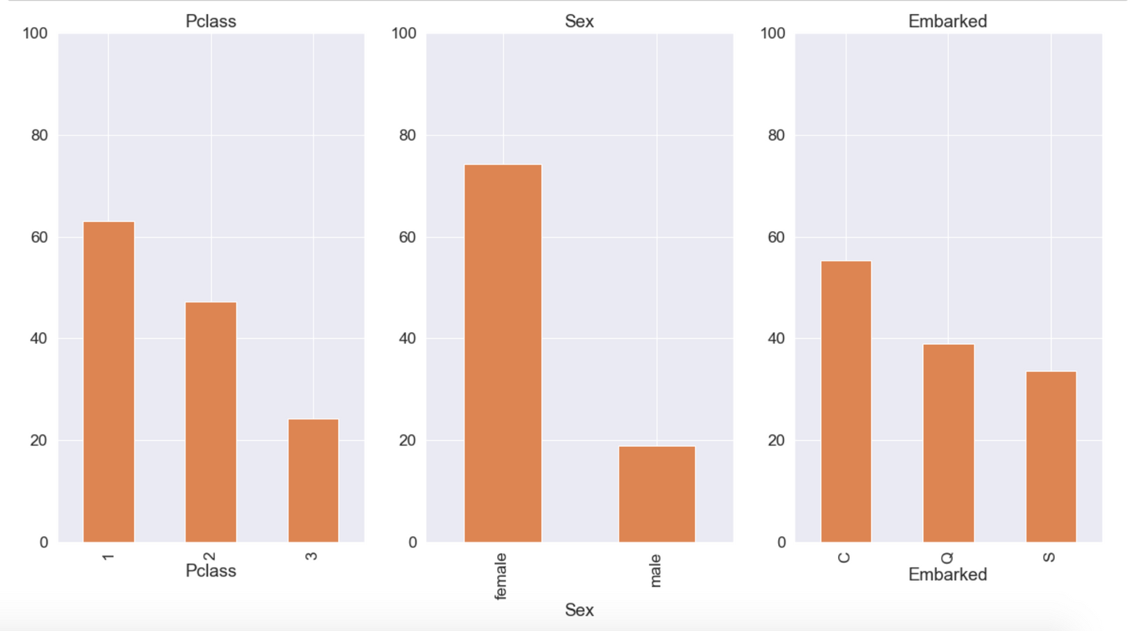
Pclass, Sex, Embarked vs Survived
MATH4995 FINAL PROJECT
06

Slide 7
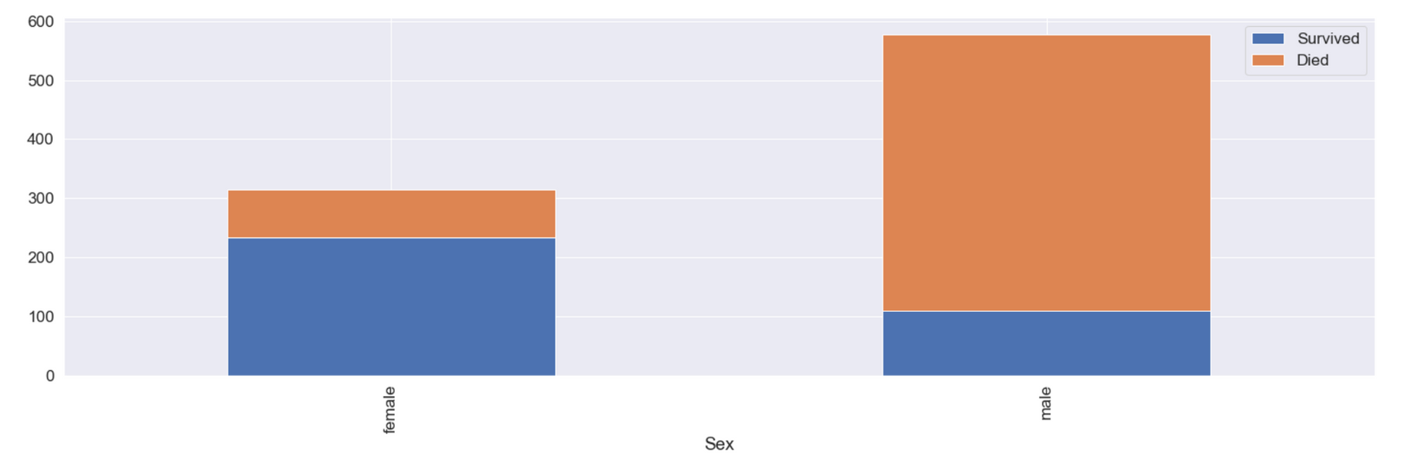
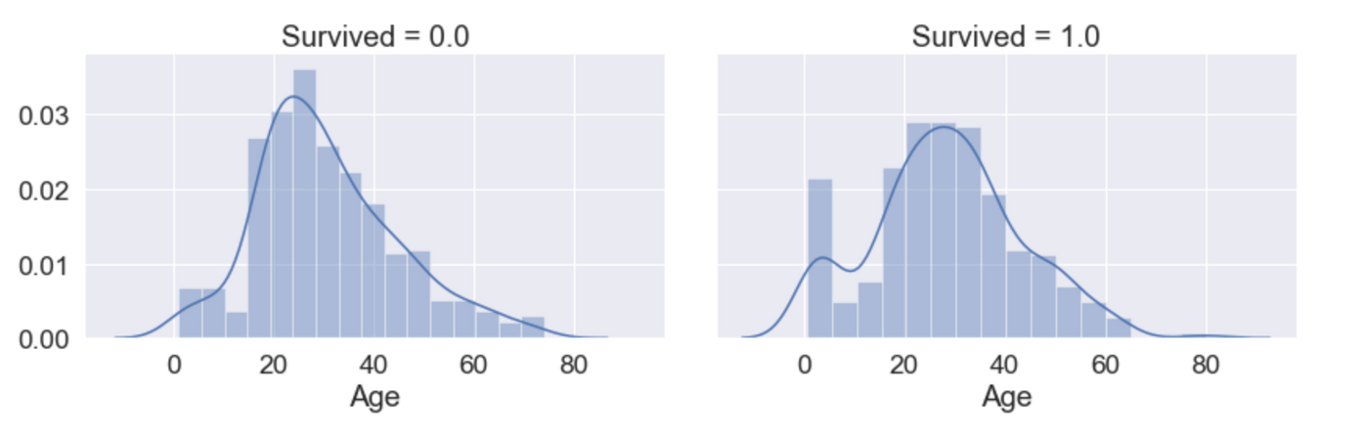
Sex and Age vs Survived (1 and 0)
02
MATH4995 FINAL PROJECT
07

Slide 8



F
E
A
T
U
R
E
E
N
G
I
N
E
E
R
I
N
G
MATH4995 FINAL PROJECT
AGE
FARE
FAMILY
SURVIVAL
24
08

Slide 9

MATH4995 FINAL PROJECT
FARE
Missing Values:
median
Fair Cut /Group
Divide Fare using qcut into 5 groups
09

Slide 10
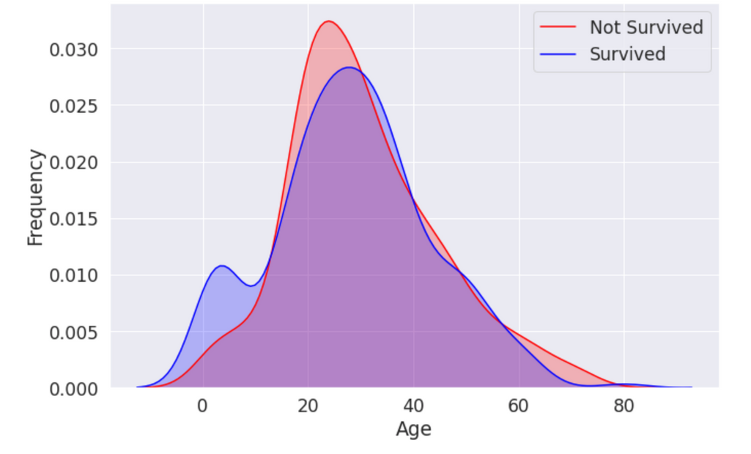
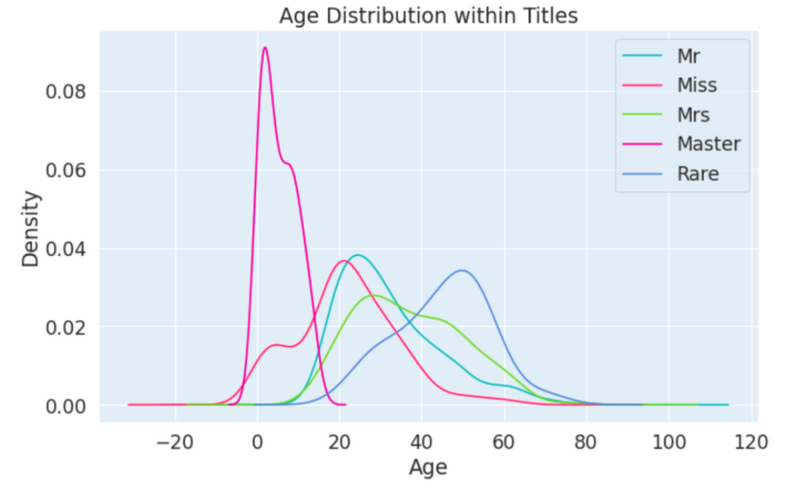
A
G
E
Age density distribution
Missing Values
The values is filled according to each of their Titles. We take the median of each Titles to fill in the missing values.
MATH4995 FINAL PROJECT
Age Divide
The plot shows that those whose age are below 16 years old have a much bigger survival rate. Therefore we divide the age into those below 16 and above.
Age distribution within Title
10

Slide 11
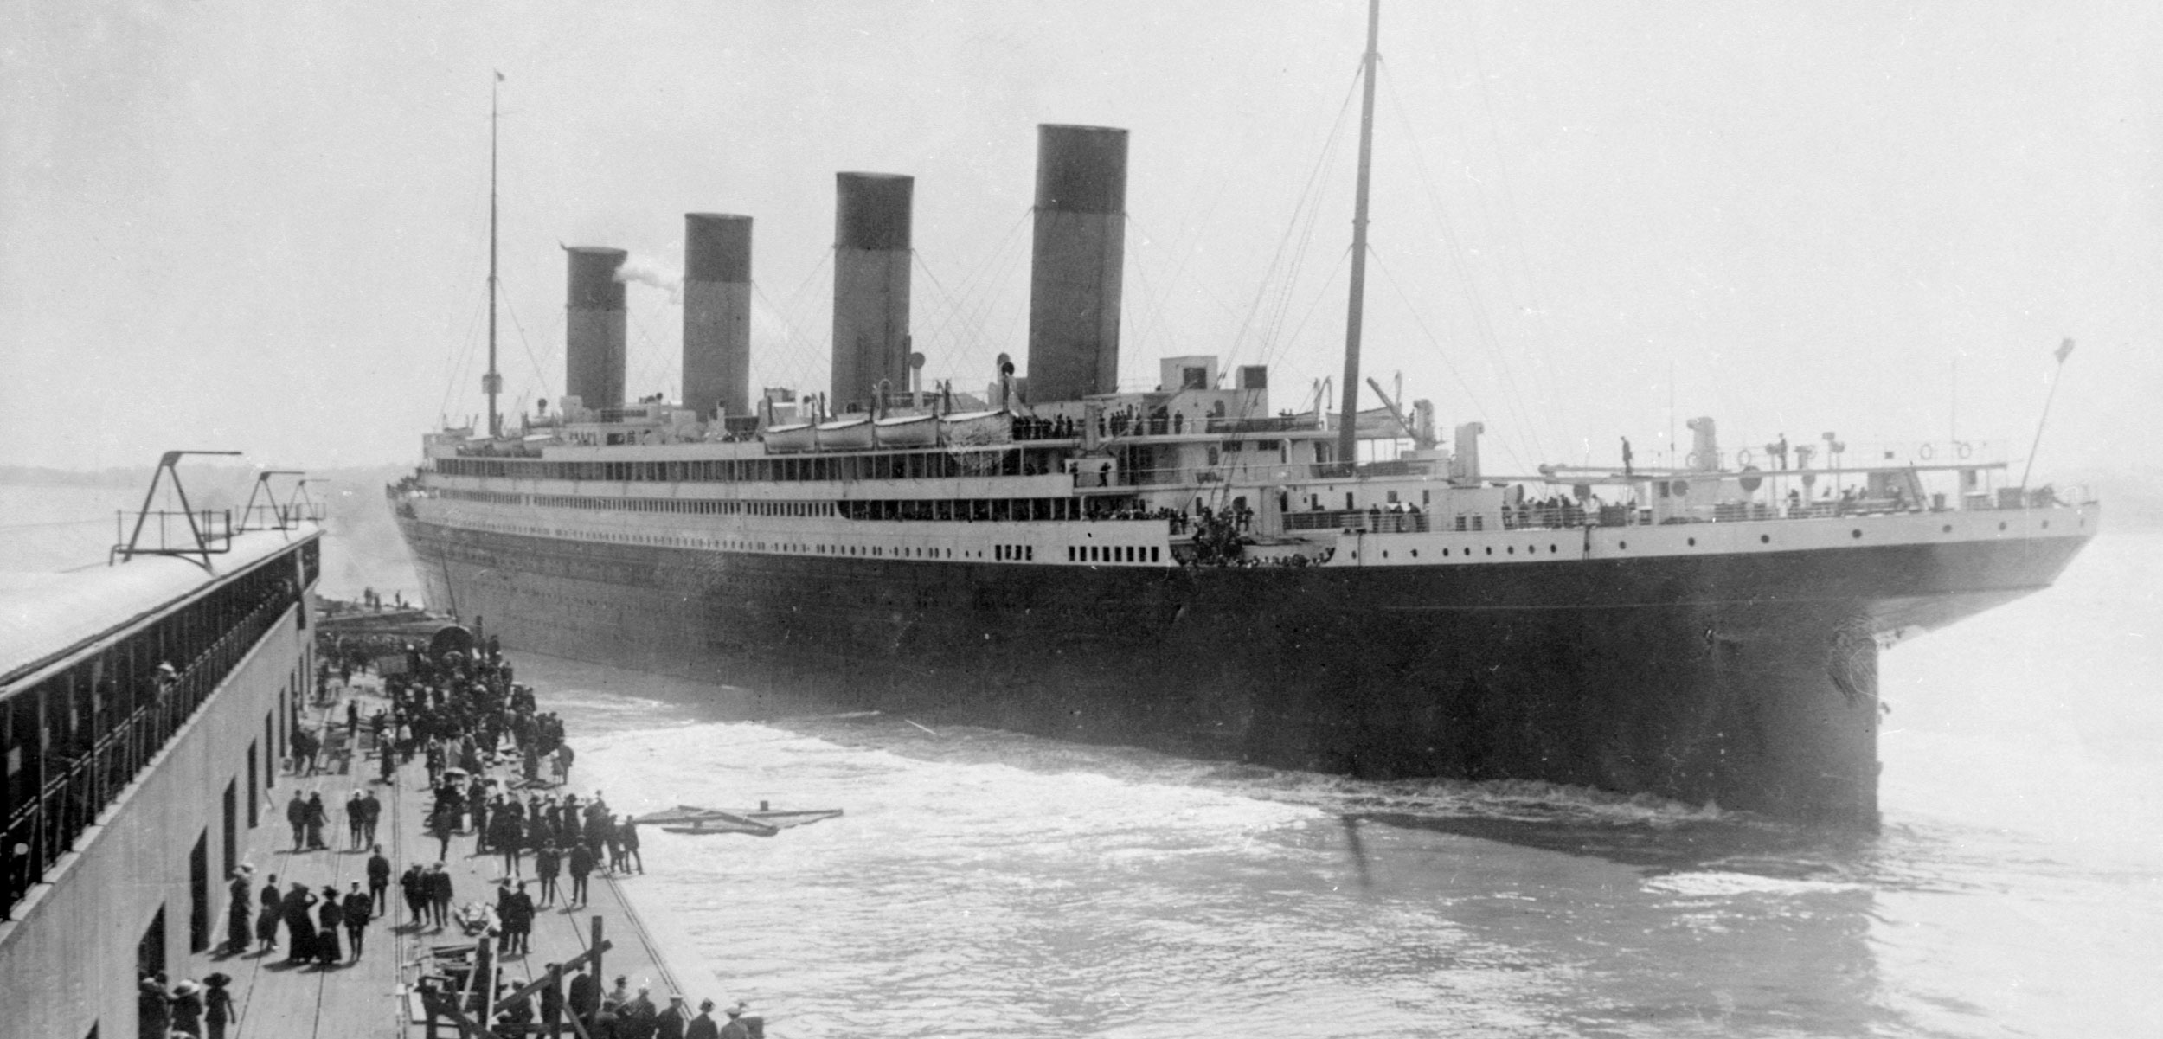
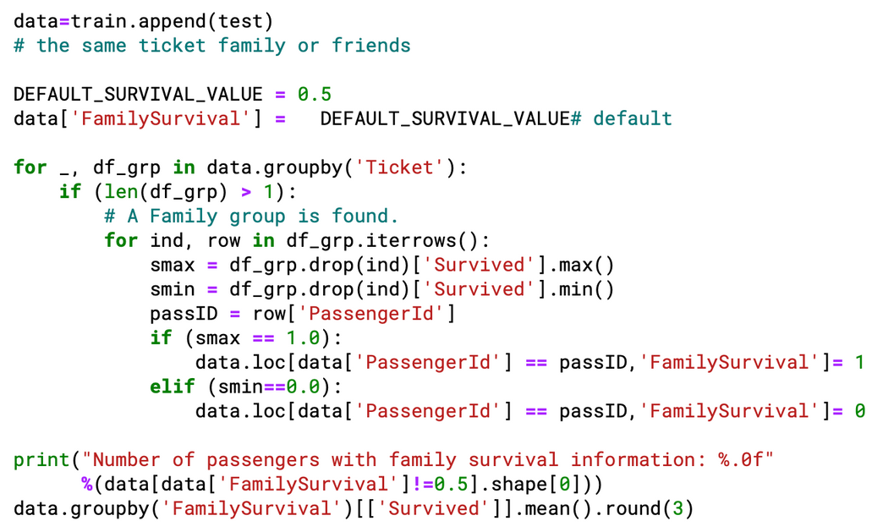
FAMILY / GROUP SURVIVAL
A feature that indicates the survival of one's family or people that travels with them. The default Family Survival value are 0.5. Those who have a surviving companions will get 1, and those with all their companions dead will get 0.
HOW DO WE COMPUTE THE VALUE?
MATH4995 FINAL PROJECT
Family/Group
Survival
13
11

Slide 12

DATA FINALIZATION
Transform all categorical variable into indicator variable
Try various combinations of feature to be used in the model in order to get maximum accuracy
Feature Used:
Sex, Pclass, Fare, Age, and Family Survival

Slide 13





OUTLINE
MATH4995 FINAL PROJECT
XGBoost
we focused on three models
Random Forest
Model Evaluation
Training
KNN
13

Slide 14


Random Forest
In accordance with our first project, where we compared many different models. This time, we also use the model that produced the highest accuracy which is the Random Forest Model.
Linear Regression Model :
Naive Bayes Classifier Model :
Random Forest Model :
Decision Tree Model :
Logistic Regression Model :
45.73%
80.13%
98.77%
98.77%
84.29%
Best online score reached
81%
14

Slide 15
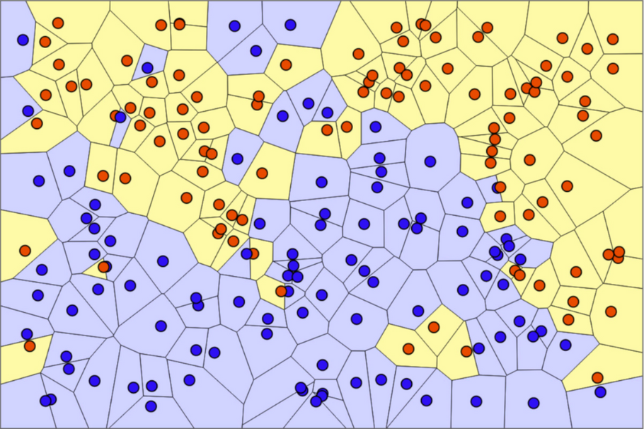
K Nearest Neighbour
Best online score reached
80%
MATH4995 FINAL PROJECT
Model Parameters
KNN is a supervised machine learning algorithm and are used to solve a classification problems
Grid Search CV is used to find the best parameters for the KNN model.
The best model yield an accuracy of 88.3% with parameters:
leaf size = 6
n neighbors = 19
weight = distance
15

Slide 16
>Xgboost method added regularization term in the loss function. Not only using the first derivative, the second derivative is also included.
>Large-scale parallel boosted tree tool, it is currently the fastest and best open source boosted tree toolkit, more than 10 times faster than common toolkits
> With parameter tuning, the best performance score we got is 84% and when submitted online it is 79%.
XGBoost
Best online score reached
79%
16

Slide 17
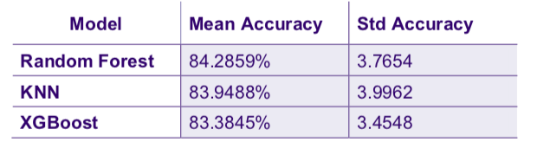
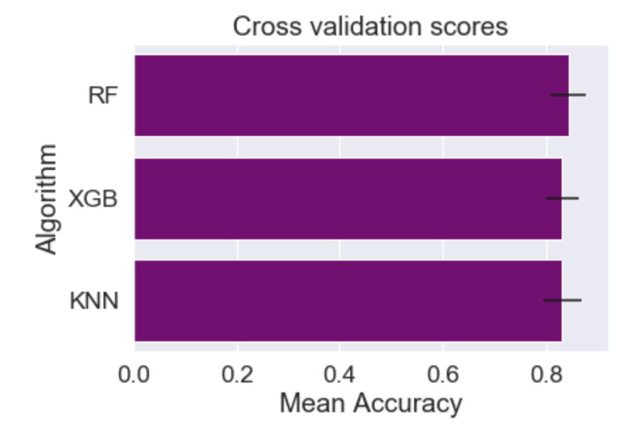
Model Evaluation
>We have fed the data into the 3 models mentioned. Now, we want to explore further which model best fit our data.
MATH4995 FINAL PROJECT
K-fold Cross Validation
>We use K-fold Cross Validation and compare the result of each model.
>From the table, we conclude that Random Forest model will produce the best results for our prediction
17

Slide 18
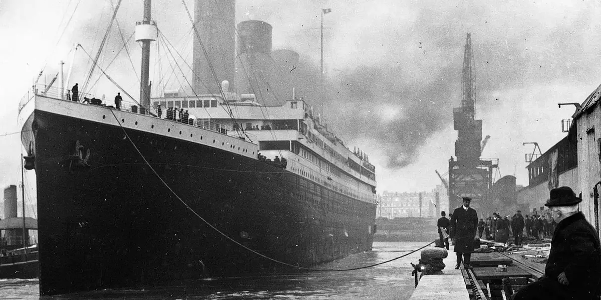
SUITABLE MODEL CHOOSING
Choosing suitable model boost up the performance and it is more unlikely to get overfitting result.
IMPORTANCE OF FEATURE ENGINEERING
MATH4995 FINAL PROJECT
The key to create a more logical model for the titanic project is feature engineering. When given 12 features, not all the features help create better result. We need to analyze and do experiments.
Conclusion
We feed the test data to the finalized model and finally obtain an accuracy score of 81.1% with an error rate of 19.9% on Kaggle website. Comparing to our first project, the accuracy has improved by 3.2%
DATA ANALYSIS AND UNDERSTANDING
It is very crucial to understand the relationship between features and how it affects the survival possibilities. This highly relies on data analysis.
18

Slide 19
Q and A
19

